Slide 1
3 C’s to a Positive Relationship

Slide 2
Cooperation:
Working together for the good of all

Slide 3
Compromise:
Each person giving up something to reach a solution that satisfies all.

Slide 4
Communication

Slide 5
What would the world be like without the internet, email, and cell phones? Would you like it better? Why?

Slide 6
What is Communication?
Sharing information, ideas, and emotions

Slide 7
How Do We Communicate?
Face-to-face
Letters
TV
Web pages
Billboards
Email
IM
Texting
Telephone
Radio
Gestures
Newspaper
Magazines
Social media
Advertisements
Gossip

Slide 8
Types of Communication
Verbal
Uses words
WHAT you say
Speaking
Talking on the phone
Writing an email
Newspapers
Texting

Slide 9
Types of Communication
Verbal
Non-verbal
Uses words
WHAT you say
Speaking
Talking on the phone
Writing an email
Newspapers
Texting
Doesn’t use words
HOW you say it
Smiling
Gestures
Posture
Tone of voice
Volume
Facial expressions

Slide 10
Listening Skills
Eye contact
Verbal feedback
Non-verbal feedback
Asking questions
Not interrupting
Paying attention
Being interested

Slide 11
Gossip
Discussion Questions
What is gossip?
How can gossip hurt people?
What motivates people to gossip?
How should we react when we hear gossip?

Slide 12
Effective Communication
Ten Ways to be an Effective Communicator

Slide 13
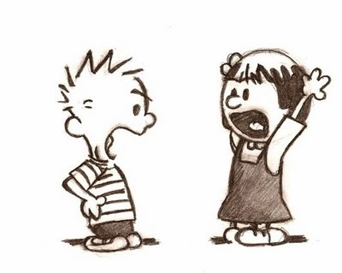
10. Never argue

Slide 14
9. Smile when talking on the phone

Slide 15
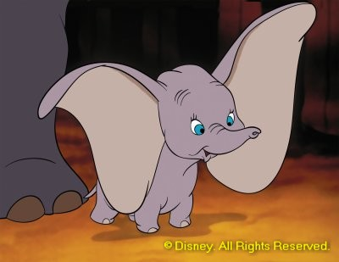
8. Listen more than you talk
2:1 Ratio

Slide 16
7. Keep the other person talking

Slide 17
6. There is something you can learn from everyone—find out what it is

Slide 18
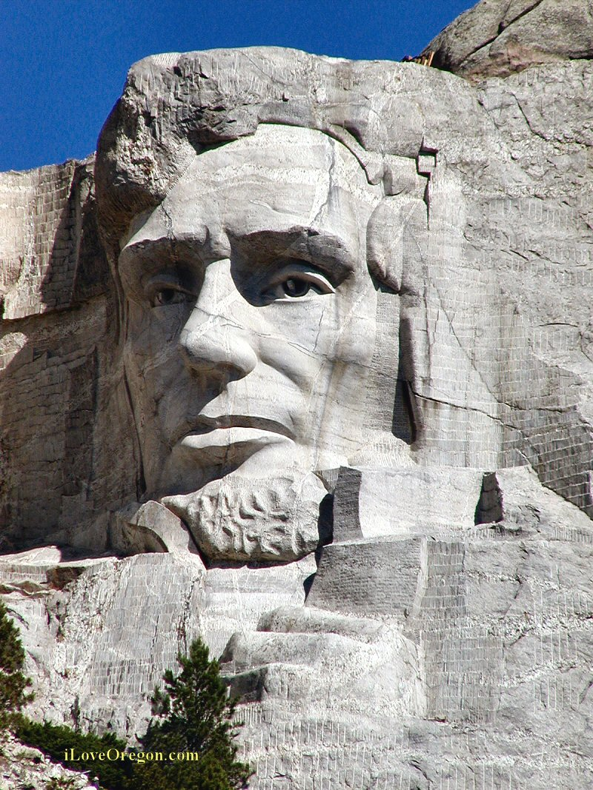
5. People usually just want sympathy, not advice

Slide 19
4. Admit when you’re wrong

Slide 20
3. Ask the right questions

Slide 21
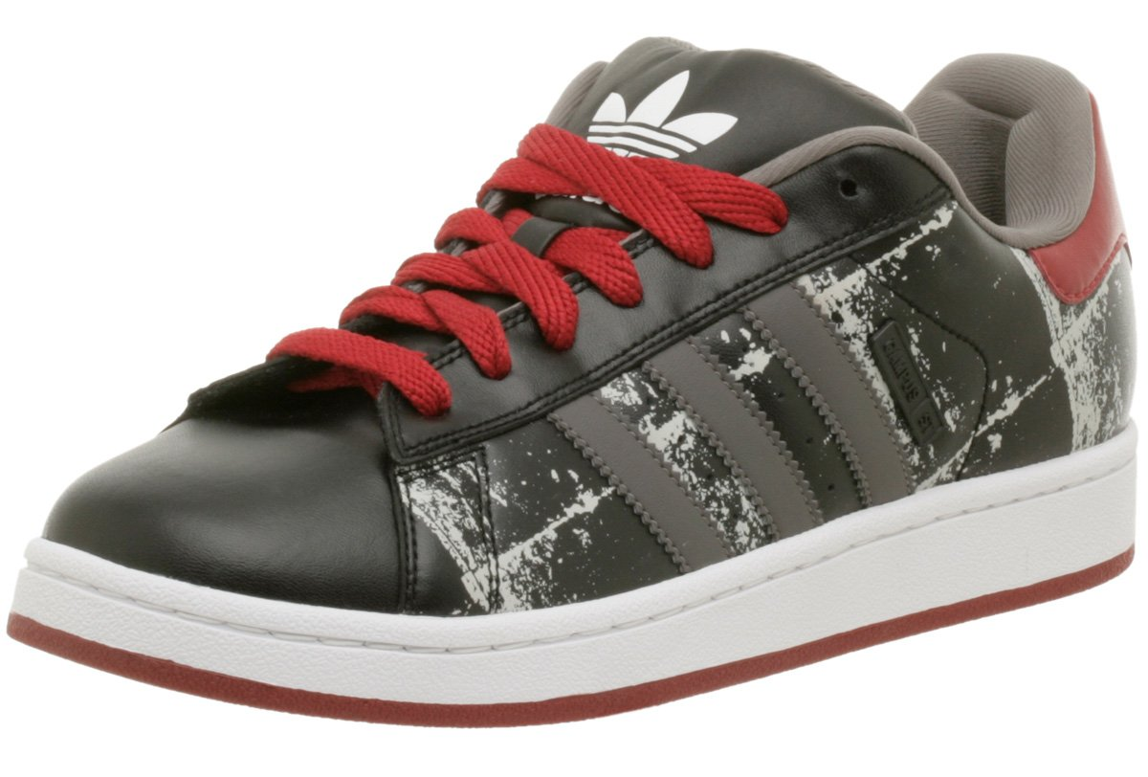
2. Seek to understand, not just be understood

Slide 22
1. Be sincere and honest

