Slide 1
Nutrition Labels

Slide 2
Regulated by the FDA
Food Labels
http://www.youtube.com/watch?v=LBko_3wT44Q

Slide 3
Which food is highest in each nutrient?
C
Peanut Butter
Ice Cream
Cereal
Pumpkin
Vegetable Juice
Yogurt
Eggs
Fiber
Cholesterol
Protein
Calcium
Vitamin C
Fat/Sugar/Calories
Vitamin A
F
A
G
E
D
B

Slide 4
How do we know which products have the various nutrients?
FOOD LABELS
Who is in charge of food labels?
FDA
Food & Drug Administration

Slide 5
Daily Value (DV%)
The amount of a nutrient needed each day to prevent deficiency.
Based on a 2,000 kcal diet

Slide 6
Nutrition Labels
Serving size information

Slide 7
Nutrition Labels
Calorie information

Slide 8
Nutrition Labels
Things to limit, with DV%
Fat
Saturated fat
Cholesterol
sodium

Slide 9
Nutrition Labels
Good things, with DV%
Potassium
Dietary Fiber
Protein
ALL of the vitamins and minerals in the next section

Slide 10
Nutrition Labels
General nutrition facts

Slide 11
Nutrient Density
When a food contains a higher percentage of the DV of a particular nutrient, than it is providing calories, it is said to be “nutrient dense”

Slide 12
Nutrient Density
For example…

Slide 13
Nutrient Density
What percentage of 2,000 kcal does an apple provide?
What percentage of your DV of fiber does it provide?
How about vitamin C?
An apple is nutrient dense for vitamin C and fiber

Slide 14
Empty Calories
Foods that provide more calories than nutrients are said to be “empty calories”

Slide 15
Nutrition Labels
Ingredients, listed by weight

Slide 16
We’ll do one together
How much is a serving?
What percentage of calories is provided?
For which nutrients is the food nutrient dense?
For which nutrients is the food NOT nutrient dense?
What are the first 5 ingredients?

Slide 17
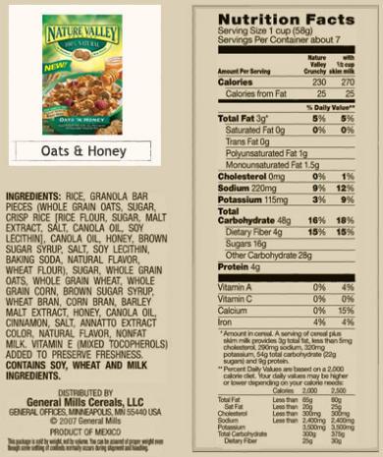
Reading Food Labels
“Digit Method” of Evaluating Food
RAISE A FINGER IF…
10% or more vitamin A
10% or more vitamin C
10% or more calcium
10% or more iron
10% (5g) or more protein
10% or more fiber
LOWER A FINGER IF…
10% or more total fat
OR
200 calories or more
OR
½ of the total carbohydrates come from sugar.
If any fingers remain up, the food is nutritious!

Slide 18
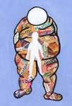
Consumption of sugar in America has increased by 30% since 1983
Contributing to…
Our soaring obesity rates
Type 2 Diabetes
Heart Disease
Osteoporosis
Hypoglycemia

Slide 19
Sugar Intake
#1 Culprit: SODA
1 can of soda has 42 g of sugar…. THAT’S OVER 10 TEASPOONS!!!!
WARNING: drinking just one can of sweetened soda or juice every day doubles your chances of getting type 2 diabetes. (American Med. Assc. August, 2004)
#2 Culprit: Low-fat/No-fat products that are loaded with sugar
#3 Culprit: Our culture. We like things sweet. Food manufacturers have found that sweetened foods are what sell.

Slide 20
What’s the limit? 40 grams, or 10 teaspoons per day
Food | Grams of Sugar | Tsp. of Sugar | % Daily Value
Snickers | 30 g | 7.5 | 75%
Low-fat Yogurt | 28 g | 7 | 70%
I C. Chocolate Ice Cream | 34 g | 8.5 | 85%
¼ C. Pancake Syrup | 42 g | 10.25 | 85%
Hostess Lemon Pie | 46 g | 11.5 | 115%
12 oz Lemonade | 49 g | 12.25 | 123%
McDonald’s med. Chocolate Shake | 84 g | 21 | 210%

Slide 21
Tips for cutting back on sugar
Eliminate Soda
Only drink Gatorade or water when working out (the other brands are only 5-10% juice… the rest is sugar water.)
Drink 100% juice.
Satisfy your sweet tooth with fruit
Order smaller portion sizes
Eat breakfast cereal that has 8 g or less of sugar and at least 2 g of fiber
Top your cereal and pancakes with fruit instead of sugar and syrup.

