Slide 1
FITNESS FOR LIFE
UNIT TWO STUDY GUIDE

Slide 2
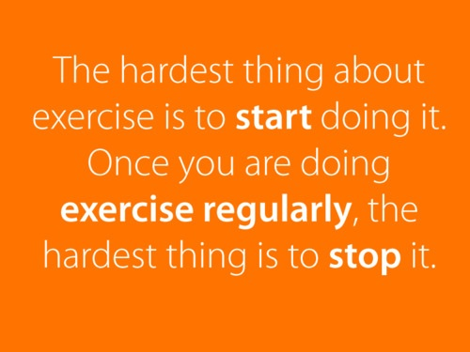
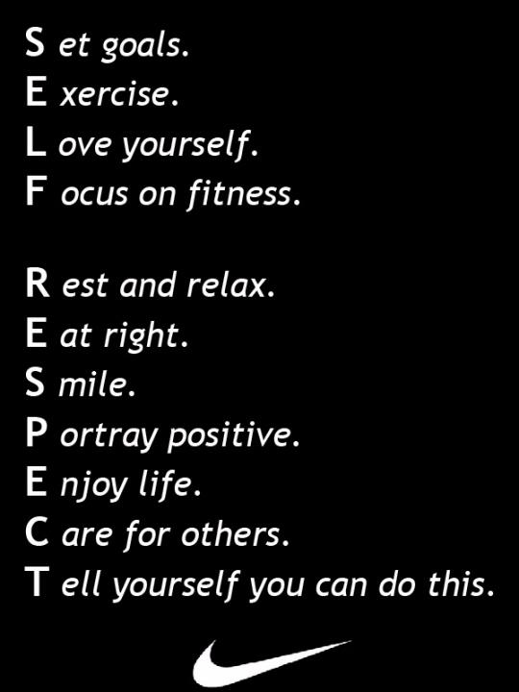
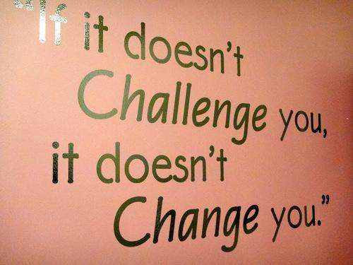
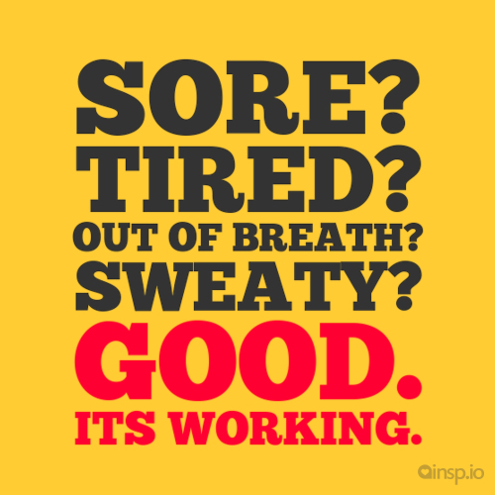
LIFESTYLE PHYSICAL ACTIVITY & ATTITUDES

Slide 3
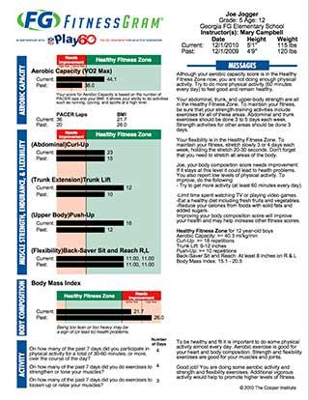
A __________________ is a brief summary of your fitness.
Fitness Profile

Slide 4
To build a fitness profile, you __________ all your self-assessment results.
SUMMARIZE

Slide 5
Why is it necessary to periodically re-evaluate your fitness program and goals?
Your body will plateau as you improve your fitness level.
You have to continually adjust your program to gradually increase
the FITT principles for your workouts in order to improve your fitness.

Slide 6
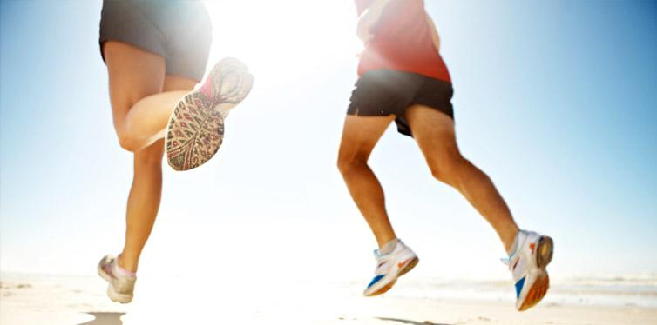
List the benefits associated with good fitness and wellness.
Improved Appearance & Self esteem
Improved physical & Mental Health
Improve Self perception
Improved energy levels
Good Posture
Stronger Heart Muscle

Slide 7
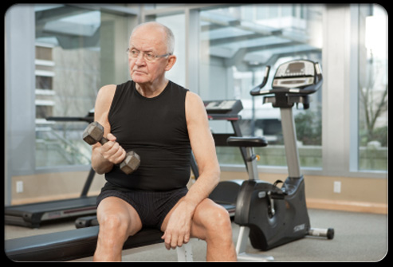
Most people become __ ____ as they grow older.
LESS ACTIVE

Slide 8
Define Hypokenetic
“Hypo”: Lack of
“Kenetic”: Movement
LACK OF PHYSICAL ACTIVITY

Slide 9
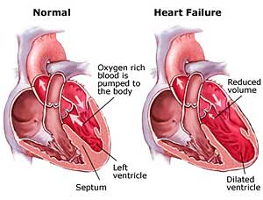
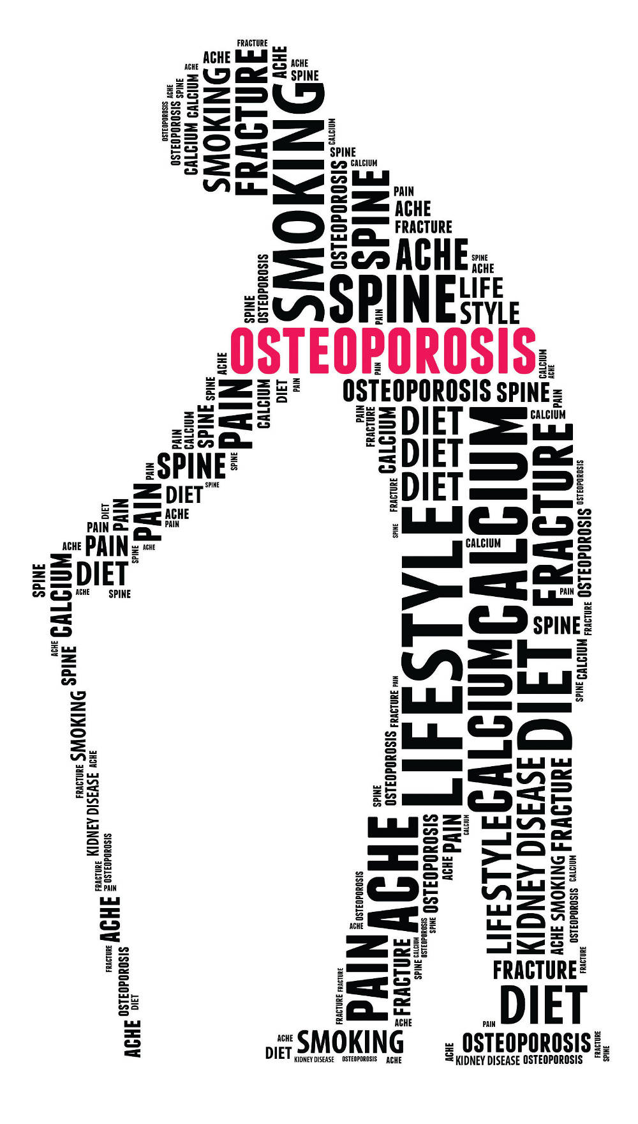
Heart Disease
High Blood Pressure
Diabetes
Osteoporosis

Slide 10
In the 21st Century, what are the three leading health problems?
Heart Disease: Failure of the heart to function properly
2. Cancer: Uncontrollable growth of abnormal cells
3. Stroke: Blood supply is severely reduced to the brain

Slide 11
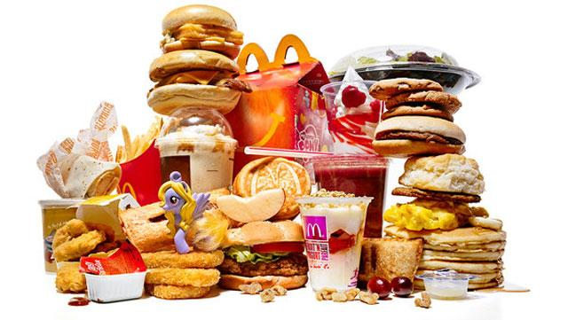
What is the risk factor?
Anything that increases a person’s chance
of health problems occurring

Slide 12
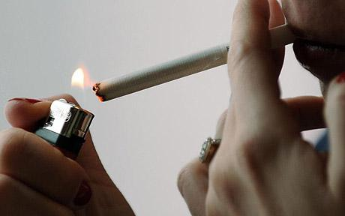
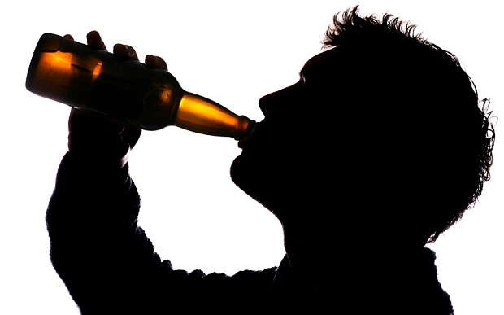
A risk factor that is considered a major contributor to a disease
List (6) Primary Risk Factors that contribute to heart disease…
Smoking
Diet
High Blood Pressure
Body Fatness
Diabetes
Sedentary Living

Slide 13
Explain the difference between controllable & non-controllable risk factors.
CONTROLLABLE: Risk factors a person can act upon to change
Smoking, Drinking, Diet, Activity Levels, Weight
NON-CONTROLLABLE:
Age, Gender, Hereditary traits, Body Type

Slide 14
Define Cardiovascular System
The body system that includes the heart, blood vessels, and blood.
Functions by moving oxygen and nutrients to body cells
and removing cell waste

Slide 16
Define Respiratory System
The body system including the lungs and air passages
Functions by bringing oxygen into the bloodstream
and eliminating carbon dioxide from the blood

Slide 17
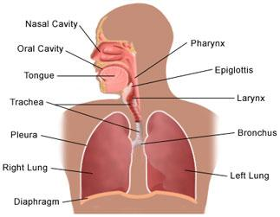
RESPIRATORY SYSTEM

Slide 18
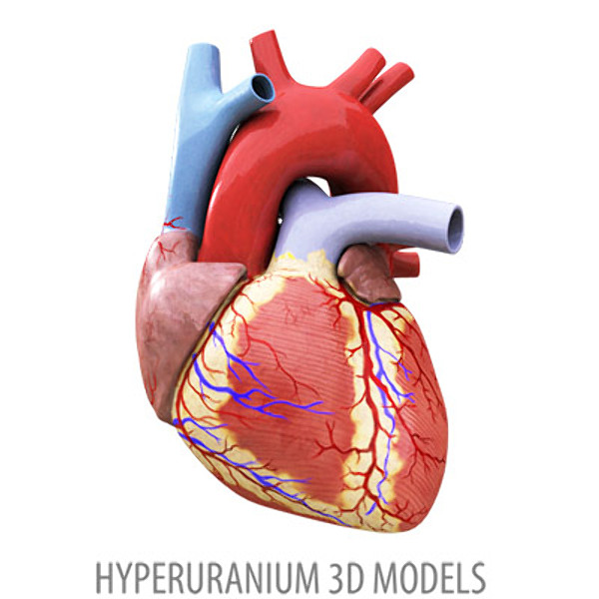
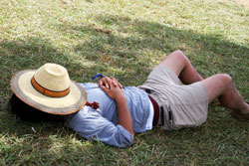
Define Resting Heart Rate
The number of heart beats during a period of inactivity

Slide 19
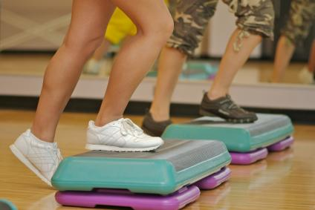
AEROBIC ACTIVITY
“With Oxygen.”
Activity that is steady enough to allow the heart
to supply oxygen your muscles need

Slide 20
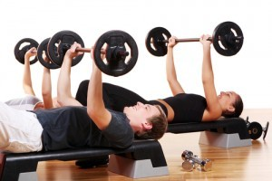
ANAEROBIC ACTIVITY
“Without Oxygen”
Activity so intense that your body cannot supply adequate oxygen
To sustain it for long periods of time.
Short Bursts of Activity

Slide 21
List the five components of Good Health
“SPIES”
S: Social
P: Physical
I: Intellectual
E: Emotional
S: Spiritual

Slide 22
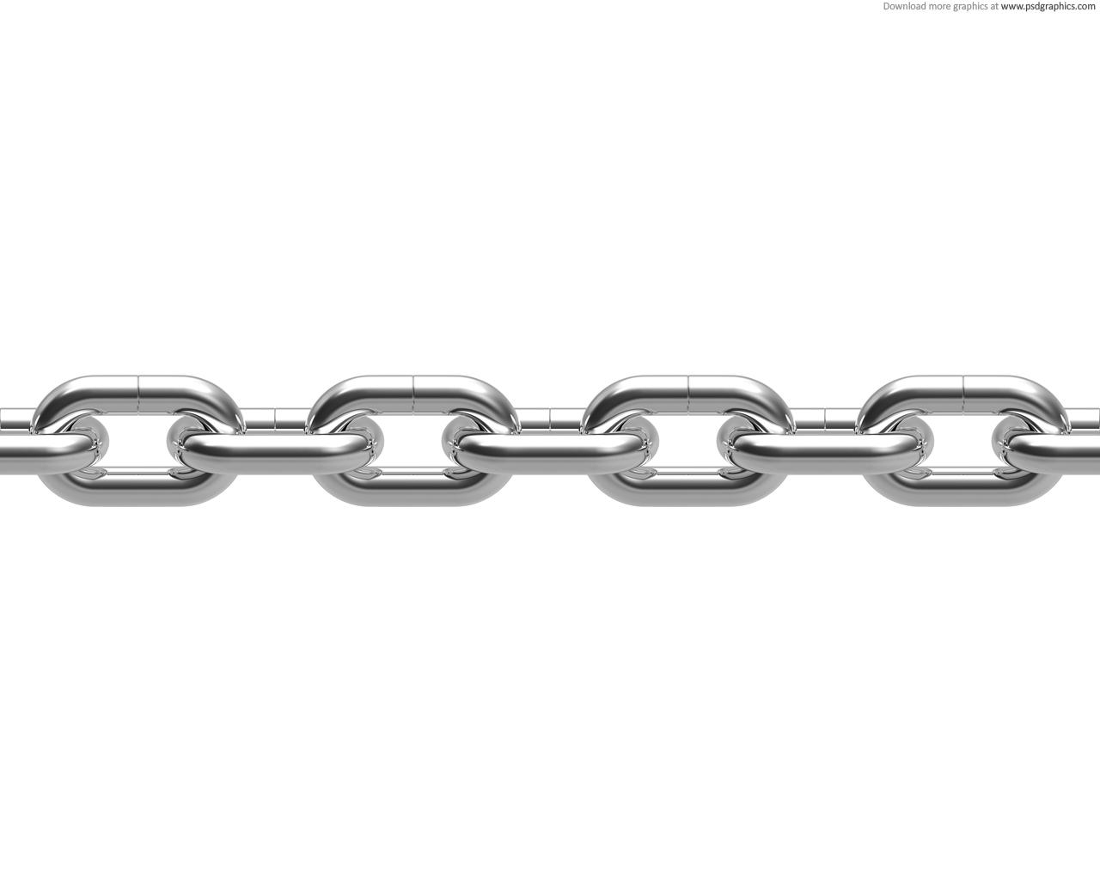
Why is a chain used to show the different components of health and wellness?
The goal for good health is to promote the positive while avoiding
the negative in each component.
Every individual must have control over each of these five components
in order to live happy & healthy

Slide 23
What are some components of the Warm-up and Cool down
Why are they important?

Slide 24
WARM UP
Gradually increase body and muscle temperature. A warm up should last for at least 5 minutes and include slow, easy movements that are similar to the activity you are planning to do.
Warming up properly helps prevent injuries during the workout!

Slide 25
COOL DOWN
Perform movements at a slower pace in order to slow down your pulse. The cool down helps prevent dizziness and fainting.
Keep the head above the heart and perform continuous movements that allow the blood to be pumped back to the heart.
In the cool down stage, STRETCHING is very important to improve flexibility

Slide 26
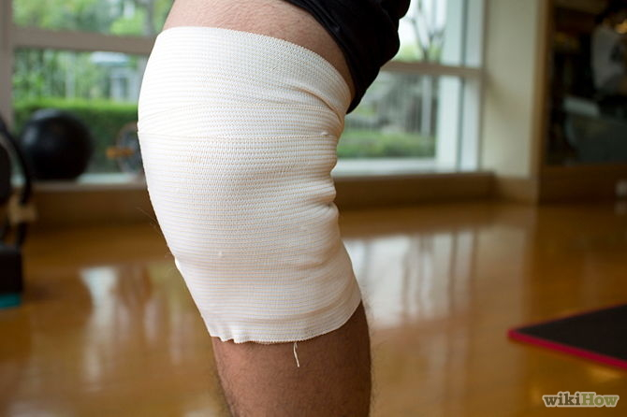
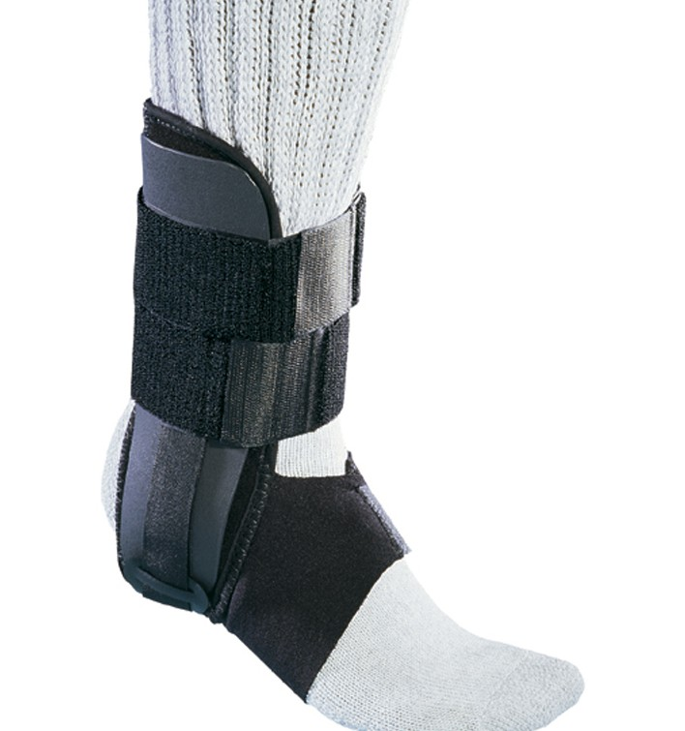
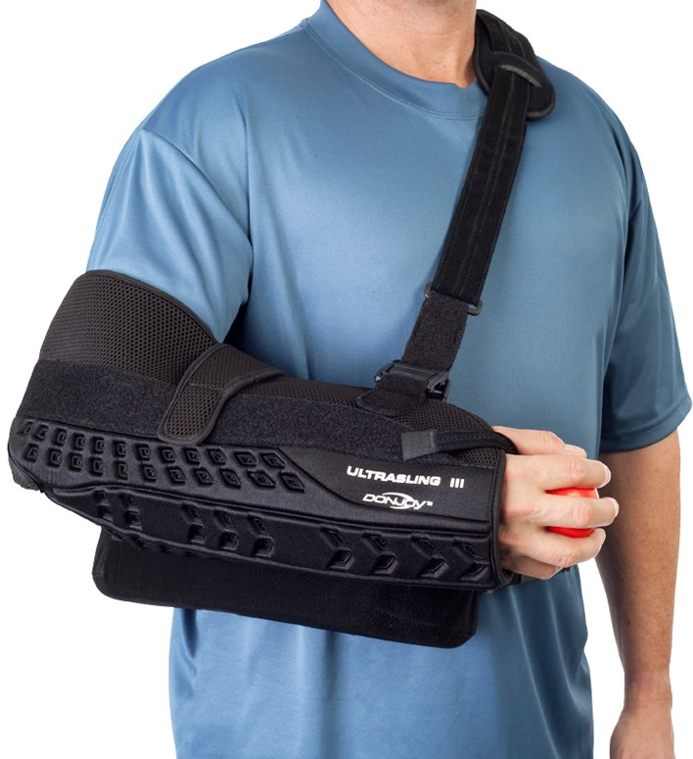
Define Overuse Injury
A body injury that occurs when
a repeated movement causes
wear and tear on the body

Slide 27
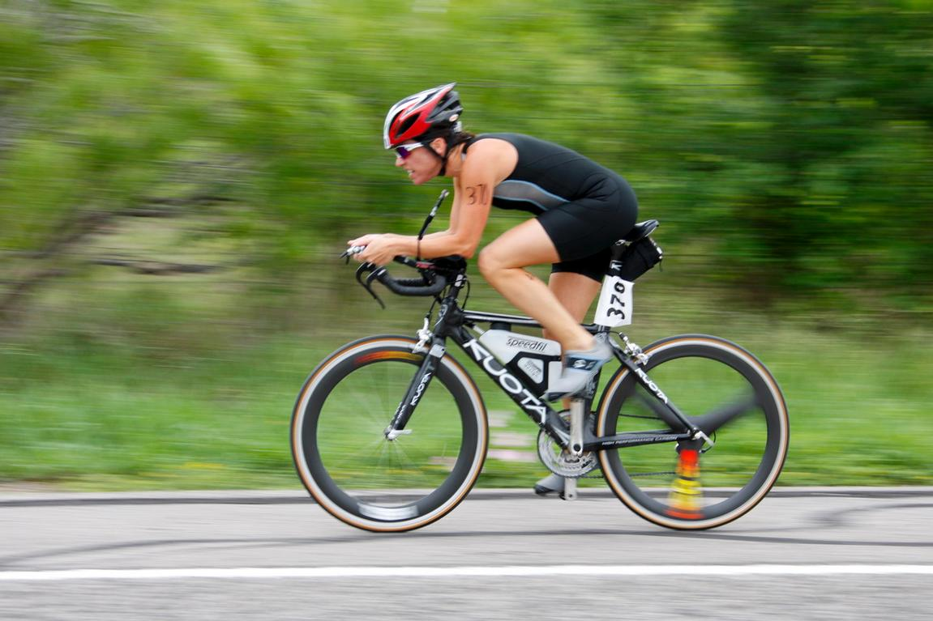
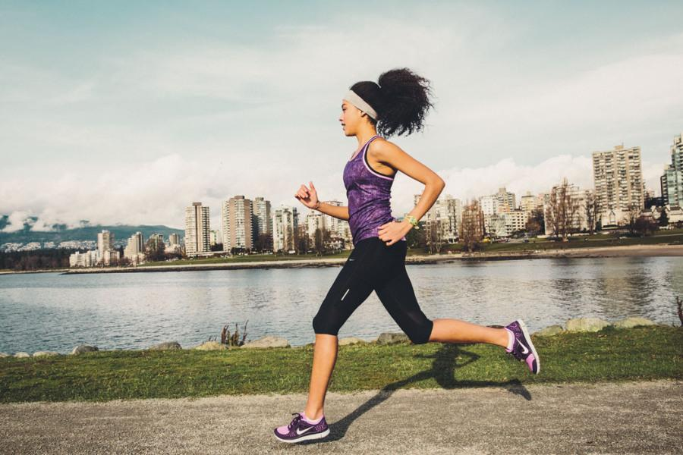
What are Biomechanical Principles?
Movement patterns related to the study of forces
that can help a person move the body efficiently
and avoid injury

Slide 28
What does R.I.C.E. stand for?
R: Rest – Get off the injury as soon as possible
I: Ice – Keep the injured area cool to prevent swelling
C: Compression – Apply pressure to the injured area to prevent swelling
and give support
E: Elevation – Keep the injured area elevated to prevent swelling and pain

Slide 29
How does the acronym S.M.A.R.T. refer to goal setting?
S: Specific – Be clear as to what you wish to accomplish
M: Measurable – Be able to track your progress
A: Attainable – The goal should be something meaningful to you
R: Realistic – Set goals that are within your abilities to accomplish
T: Time Bound – Have a set finish point

Slide 30
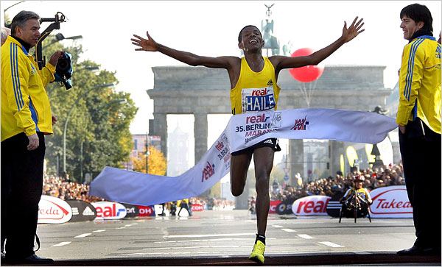
What is a Long Term Goal?
Goals that you can expect to accomplish in months
or over the course of a year!

Slide 31
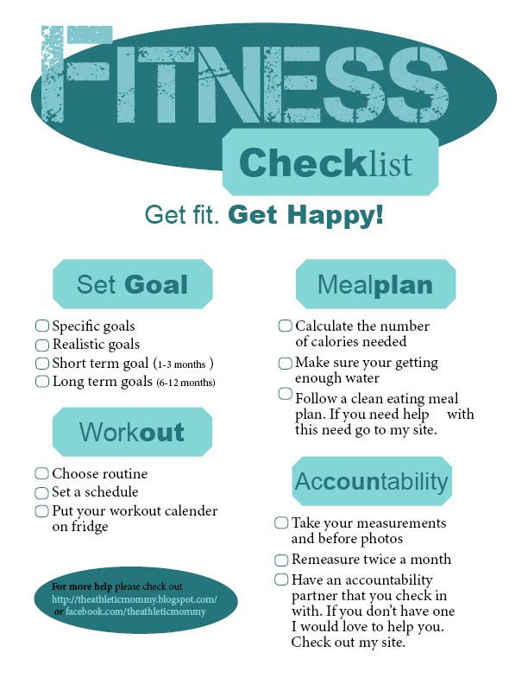
What is a Short Term goal?
Goals that you expect to accomplish
in several days or weeks

Slide 32
LONG & SHORT TERM GOALS
Write a Short and Long term goal that you have set for yourself to improve your Fitnessgram scores this semester!

Slide 33
DISCUSSION QUESTION
What are some healthy lifestyles you now practice?
What are some healthy lifestyles your family practices?
What changes would you make to your lifestyle to improve your personal health and wellness?

