Slide 1
FAMILIES!!!
Families are the “BASIC UNIT OF SOCIETY”
First Relationships
Learn to love, respect, get along with others and function as part of a group
Interdependence (one person’s actions affect the lives of other family members)
Life lessons

Slide 2
What causes a family Dynamic to change?
More women are in the workforce
More are educated
People have begun postponing marriage and parenthood until their 30’s and 40’s
Media
-What else?
Because of changing families we have many different types of families.

Slide 3
What is the purpose of a family?
Socialization:
The process of teaching children to behave in a way that is acceptable to the family and to society.
How has socialization played a role in your family?
IE: Manners, becoming responsible, respecting others, giving and receiving love, values, beliefs , customs & traditions!

Slide 4
Types of Families
Nuclear Family: Mother, father and children (biological or adopted)
Single Parent Family: One parent and children, formed from divorce, death, or single person adopting.
Extended Family: Aunts, uncles, grandparents, etc.
Blended Family: Biological parent, a stepparent and children of one or both parents.
Foster Family: An adult or couple provides care and a temporary home for children whose biological parents are unable to care for them.
Couple: Husband and Wife
Group of People

Slide 5

HOW TO GET ALONG WITH THE PARENTALS…
Do you say?
Please
Thank you
I love you
USE THESE IMPORTANT WORDS
There is POWER and MAGIC in each.

Slide 6

Closing the Gap
“Yeah, but you don’t know my dad. He’s never going to change. He’s impossible.”
Well, maybe he is impossible and maybe he won’t ever change. But you can.

Slide 7
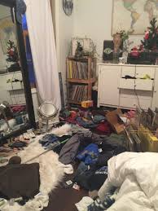
Skills to building a POsitive family relationship
SKILL #1- Think WIN-WIN
Are you always thinking about what’s in it for you, without thinking about what’s in it for them?
Ex: Reggie’s story

Slide 8
Skill #2- Seek first to UNderstand, then to be understood
Curfew Scenario
*Listen then Talk
*Mirroring
Here are some great Seek First to Understand phrases to use”
“So, you’re saying that…”
“As I get it, you feel…”
“If I understand you correctly, you think…”
“You feel ________________about ____________.”

Slide 9
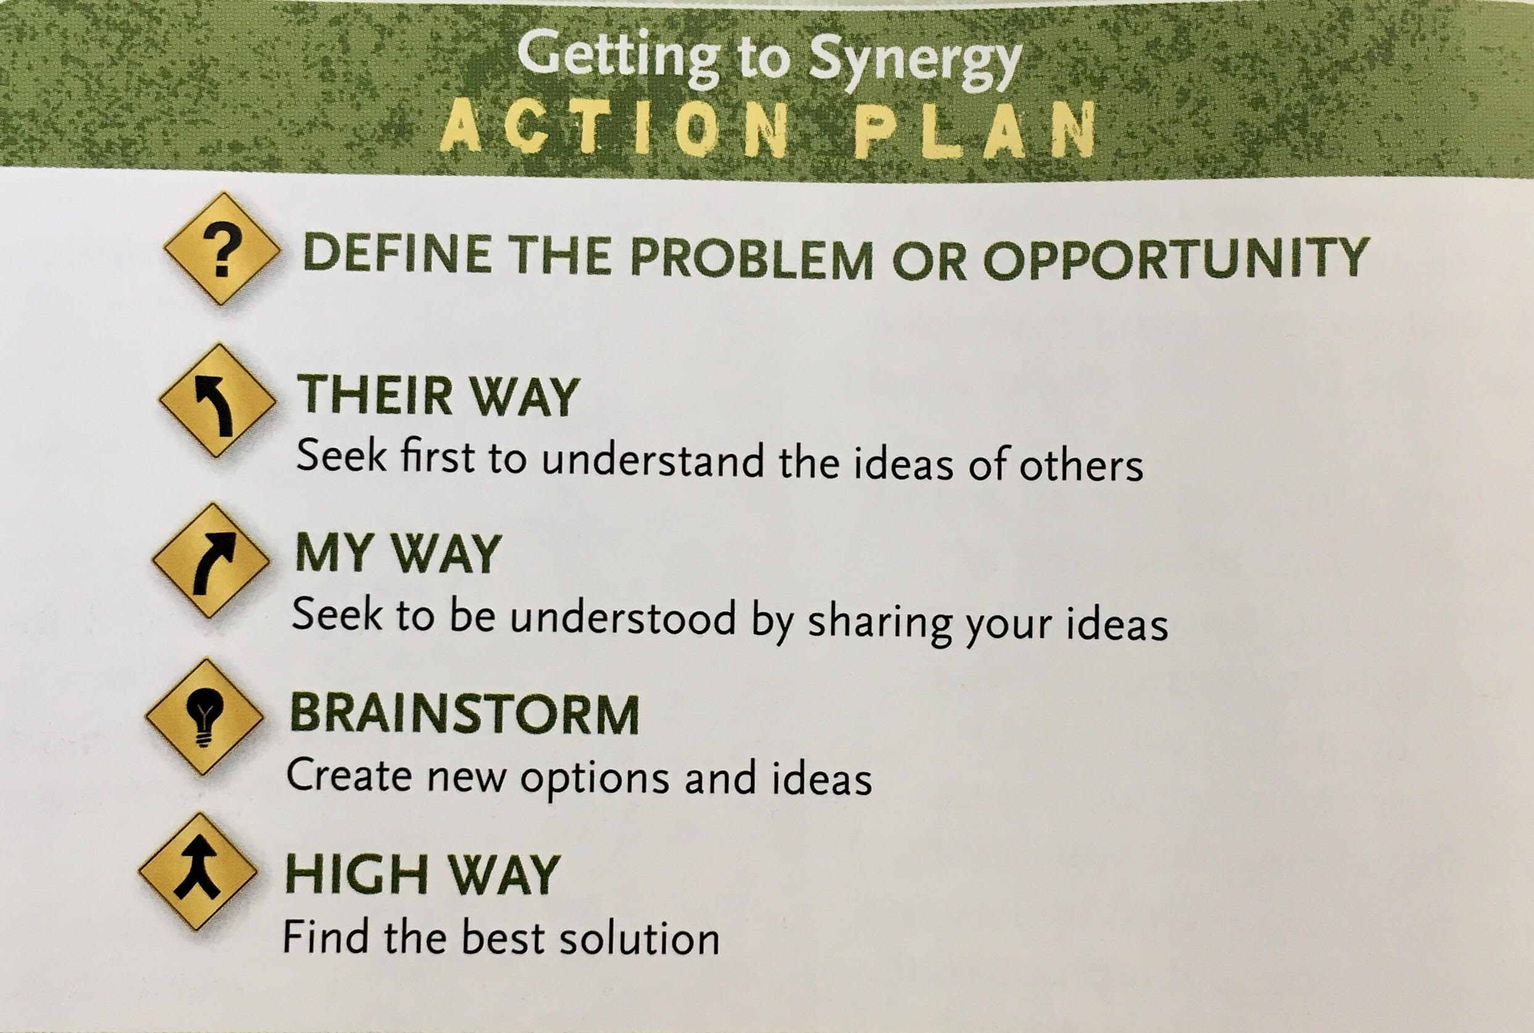
Skill #3- Synergize

Slide 10
When you have to raise your parents…
Pg. 162 in health textbook

