Slide 1
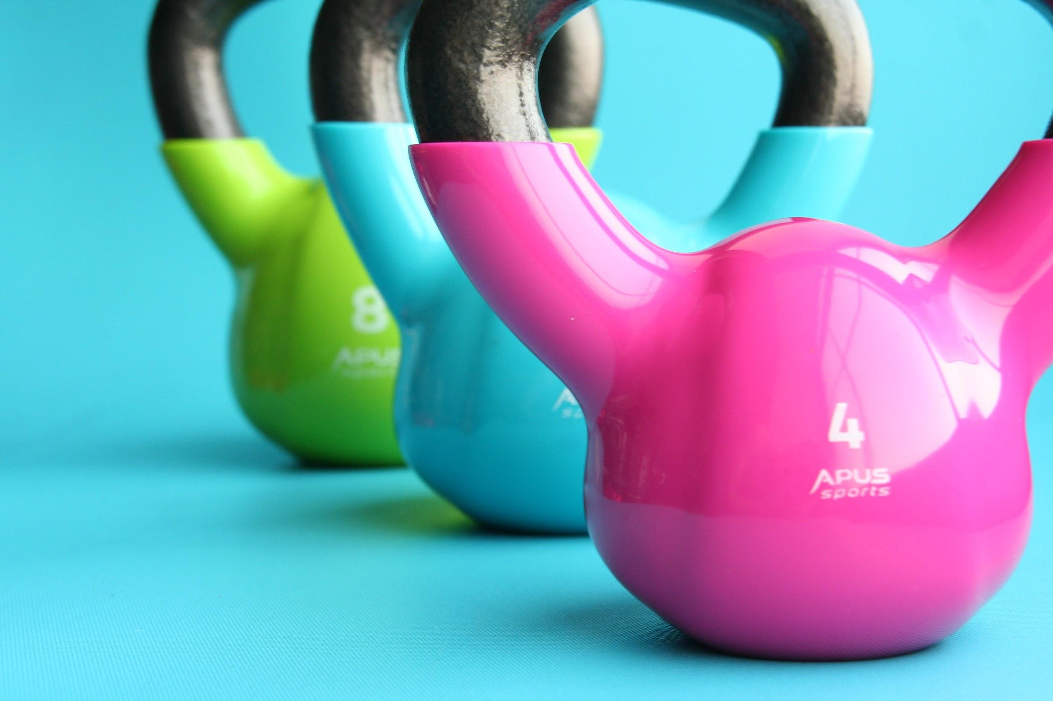
FIT FOR LIFE
Unit 3

Slide 2
Define Health-Related Physical Fitness
The ability of your body system to work together efficiently to allow you to be healthy and effectively perform activities of daily living.

Slide 3
DEFINE THE FOLLOWING LETTERS IN THE F.I.T.T. ACRONYM

Slide 4
FREQUENCY
HOW OFTEN YOU DO PHYSICAL ACTIVITY

Slide 5
INTENSITY
HOW HARD YOU PERFORM PHYSICAL ACTIVITY

Slide 6
TIME
HOW LONG YOU DO PHYSICAL ACTIVITY

Slide 7
TYPE
THE KIND OF ACTIVITY YOU DO TO BUILD A SPECIFIC PART OF FITNESS

Slide 8
FILL IN THE FITT PRINCIPLES THAT CORRESPONDS TO THE FOLLOWING HEALTH-RELATED FITNESS COMPONENT.

Slide 9
CARDIOVASCULAR FITNESS
F: 3 – 6 DAYS A WEEK
I: MODERATE TO VIGOROUS ACTIVITY (THRZ)
T: 20 OR MORE MINUTES
T: JOGGING, AEROBICS, SWIMMING, DANCING, BIKING

Slide 10
STRENGTH
F: 2 – 3 DAYS OF THE WEEK ON NON-CONSECUTIVE DAYS
I: 60 – 90% OF 1 RM
T: 1 TO 2 SETS / 3 TO 8 REPS
T: WEIGHT TRAINING

Slide 11
MUSCULAR ENDURANCE
F: 3 DAYS PER WEEK
I: 20% OF 1 RM
T: 1 - 2 SETS / 11 – 25 REPETITIONS
T: CROSSFIT, BOOTCAMP, CIRCUIT TRAINING, CROSS COUNTRY RUNNING, SWIMMING

Slide 12
How is strength training different from muscle endurance training?
STRENGTH: High Resistance, Low Reps
ENDURANCE: Low Resistance, High Reps

Slide 13
Define the three basic principles of exercise.

Slide 14
Principle of Overload
Requiring the body to do more than it usually does.

Slide 15
Principle of Progression
The amount and intensity of your exercise should be increased gradually.

Slide 16
Principle of Specificity
Specific types of exercises improve specific parts of fitness.

Slide 17
What does THRZ stand for? What is the importance of this zone?
Target Heart Rate Zone
It is recommended to stay within your personal training zone when exercising!

Slide 18
Threshold of Training (Lower Limit THRZ)
The minimum amount of overload needed to build physical fitness
FORMULA: MHR x (.65)
MHR= Maximum Heart Rate.
Usually 220-your age Ex: 220-16= 204mhr

Slide 19
Target Ceiling (Upper Limit THRZ):
The maximum amount of overload during physical activity
FORMULA: MHR x (.90)

Slide 20
Computing Target Heart Rate Zone
Step One: 220 – (Age) = Maximum Heart Rate (MHR)
Step Two: MHR x ( .65) = Threshold of Training
Step Three: MHR x (.90) = Target Ceiling

Slide 21
COMPLETE THE FOLLOWING…
Using the Target Heart Rate Formula…
Calculate your personal target heart rate zone!
Write your answers by each step on the study guide

Slide 22
Resistance
A force that acts against the muscles

Slide 23
Repetitions
The number of consecutive times a person does and exercise.

Slide 24
Set
A group of repetitions of a specific exercise.

Slide 25
Define Static Stretching
Stretching and holding the muscle just beyond its normal limits.

Slide 26
Define Ballistic Stretching
stretching and bouncing just beyond the muscles normal limits.

Slide 27
Exclusive use of __________ exercises can lead to a loss of _________.
Strength
Flexibility

Slide 28
What is Lean Tissue?
Lean Tissue includes muscles, bones, skin, and body organs.

Slide 29
More than ____ of all adults are considered to be too fat or obese.
70%

Slide 30
List the factors that influence body composition

Slide 31
Heredity
Characteristics passed from parents to their children

Slide 32
Basal Metabolism
The amount of energy the body uses just to keep living

Slide 33
Maturation
The process of becoming fully grown and developed physically

Slide 34
Diet
What we eat affects our weight and body composition
Caloric Intake

Slide 35
Physical Activity
Activity levels & Exercise determine how many calories we burn
Caloric expenditure

Slide 36
Essential Body Fat:
Minimum amount of body fat needed for good health.

Slide 37
Define Anorexia Nervosa
An eating disorder characterized by severely restricting food intake.

Slide 38
Define Bulimia
An eating disorder characterized by binge eating and then purging.

Slide 39
What is self-perception?
It is how you think other people view you and your own feelings about your appearance.

Slide 40
How can you improve self-perception?
Perform regular physical activity
Don’t compare yourself to others
Think positively about yourself
Consider how your behavior/actions affect others
Eat a well-balanced diet

Slide 41
List the (6) essential nutrients and what function they perform in the body

Slide 42
CARBOHYDRATES: Main source of energy in the body
PROTEIN: Builds, repairs, and maintains body cells “Building Blocks”
FATS: Necessary for growth and repair of cells; Dissolves certain vitamins and carries them to cells
MINERALS: Regulate the activities of cells; Calcium, Iron, Sodium
VITAMINS: Growth and repair of body cells; Vitamin B & C everyday
WATER: Single most important nutrient in the body; Carriers nutrients through the body, carries away waste, regulates temperature

Slide 43
Fill in the Physical Activity Pyramid below.
Make sure to write the level number and name!!
Level: 4
Level: 3
Level: 2
Level: 1
Sedentary Living
Muscle
Fitness
Flexibility
Active Sport & Recreation
Active Aerobics
Lifestyle Physical Activity

